Slide 1
Análisis precio departamentos plaza Ñuñoa 1 de julio 2019

Slide 2
Descripción
Fecha Consulta: 1 de Julio de 2019
Datos de venta de departamentos en el barrio Plaza Ñuñoa
Fuente: portalinmobiliario

Slide 3
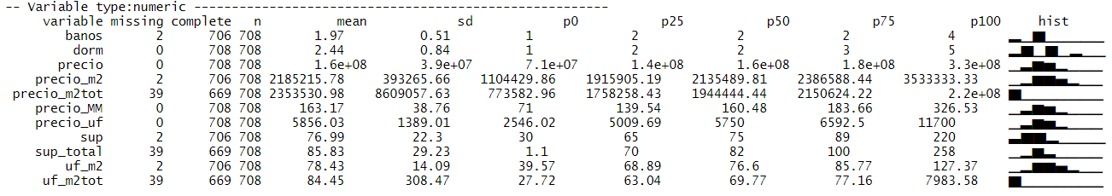
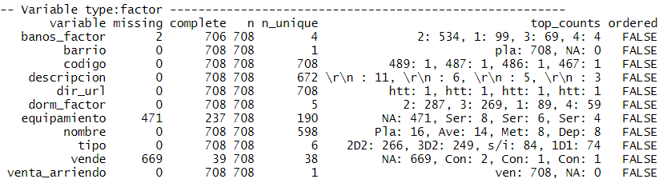
Datos Promedio
Datos promedio
Baños | 1.97
Dormitorio | 2.44
Precio | 5856
Superficie | 77
Superficie total | 86
UF por m2 | 78.43
n | 708

Slide 4
Tablas resumen

Slide 5
Datos por Dormitorios/Baño: Precio Total (MM y UF)
tipo | count | precio.p10 | precio.mean | precio.p90 | precioUF.p10 | precioUF.mean | precioUF.p90
1D1B | 74 | $84 | $106 | $130 | $3,003 | $3,811 | $4,666
2D1B | 20 | $99 | $125 | $166 | $3,569 | $4,497 | $5,937
2D2B | 266 | $130 | $156 | $185 | $4,663 | $5,594 | $6,695
3D2B | 249 | $144 | $176 | $219 | $5,176 | $6,322 | $7,852
3D3B | 15 | $138 | $199 | $249 | $4,930 | $7,147 | $8,920

Slide 6
Datos por Dormitorios/Baño: Precio por m2 total
tipo | count | precio.p10 | precio.mean | precio.p90 | precioUF.p10 | precioUF.mean | precioUF.p90
1D1B | 74 | $1,708,781 | $2,347,618 | $3,103,963 | $61 | $84 | $111
2D1B | 20 | $1,391,429 | $1,835,561 | $2,418,384 | $50 | $66 | $87
2D2B | 266 | $1,768,206 | $2,208,606 | $2,383,229 | $63 | $79 | $85
3D2B | 249 | $1,583,746 | $1,845,360 | $2,144,005 | $57 | $66 | $77
3D3B | 15 | $1,390,041 | $1,826,690 | $2,362,982 | $50 | $65 | $85
Superficie m2
tipo | count | sup.p10 | sup.mean | sup.p90 | supTotal.p10 | supTotal.mean | supTotal.p90
1D1B | 74 | 33 | 42 | 50 | 35 | 47 | 62
2D1B | 20 | 48 | 60 | 80 | 51 | 71 | 88
2D2B | 266 | 56 | 69 | 80 | 62 | 77 | 89
3D2B | 249 | 74 | 87 | 100 | 78 | 97 | 115
3D3B | 15 | 66 | 96 | 123 | 69 | 114 | 155

Slide 7
BOXPLOT

Slide 8
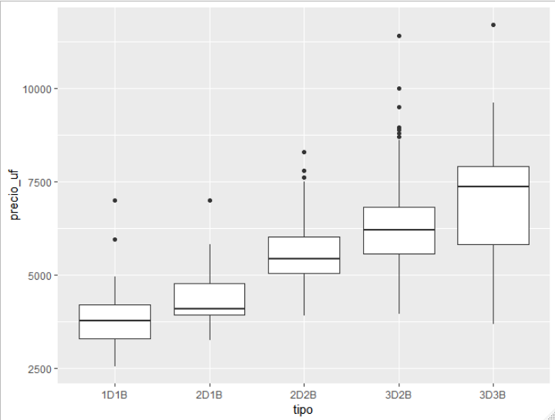
Precio vs Tipo

Slide 9
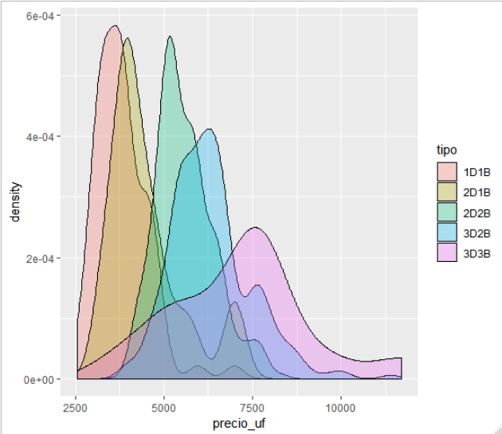
Distribución precio por Tipo

Slide 10
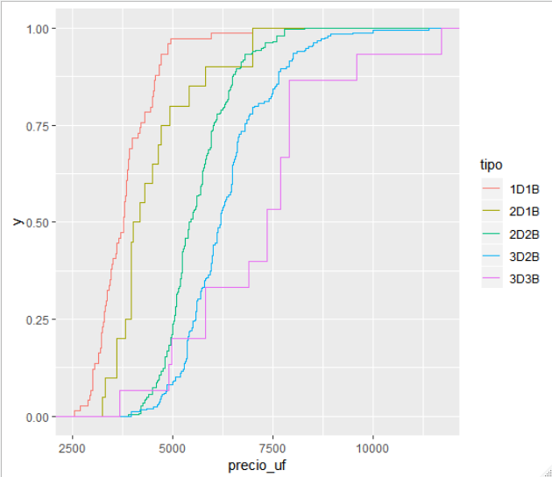
Distribución precio por Tipo

Slide 11
Scatter

Slide 12
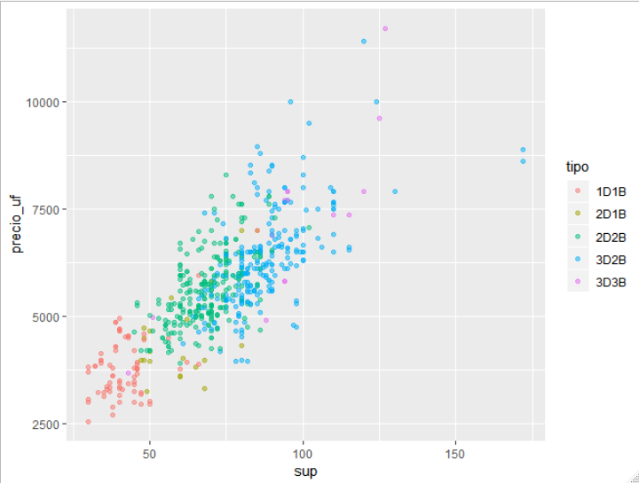
Precio vs Superficie útil

Slide 13
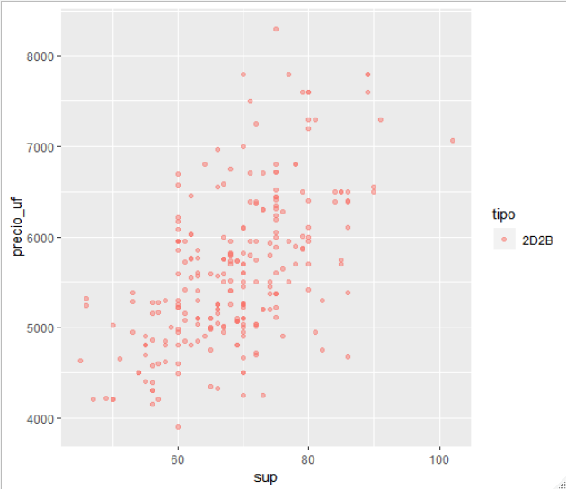
Precio vs Superficie útil: 2D2B

Slide 14
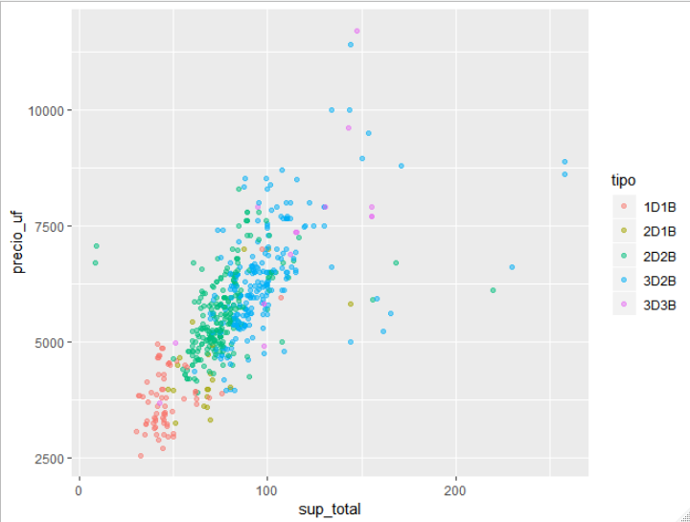
Precio vs Superficie total

Slide 15
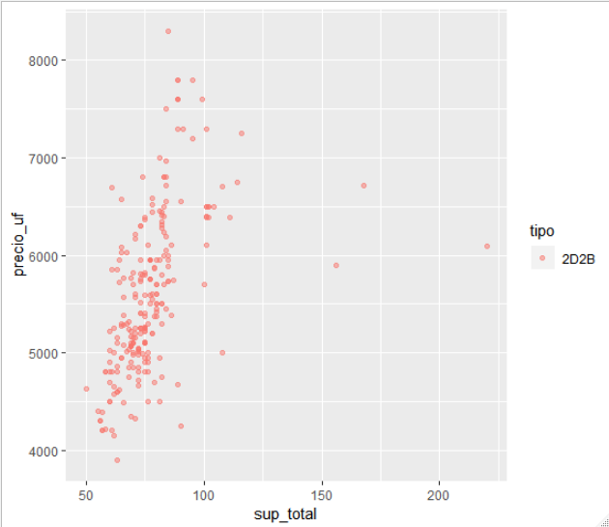
Precio vs Superficie total: 2D2B

Slide 16
Dividendos estimados según precio

Slide 17
Dividendo aproximado a un plazo de 20 años
 |  | Porcentaje_Pie | Valor
 |  | 10% |  | 15% |  | 20%
Precio_UF | Tasa_Interes_Anual | Dividendo | Renta Requerida | Dividendo | Renta Requerida | Dividendo | Renta Requerida
4000 | 3.00% | $547,048 | $2,188,191 | $516,656 | $2,066,625 | $486,265 | $1,945,059
 | 3.50% | $571,370 | $2,285,480 | $539,627 | $2,158,509 | $507,885 | $2,031,538
 | 4.00% | $596,197 | $2,384,786 | $563,075 | $2,252,298 | $529,953 | $2,119,810
 | 4.21% | $606,770 | $2,427,081 | $573,061 | $2,292,243 | $539,351 | $2,157,405
 | 5.00% | $647,298 | $2,589,192 | $611,337 | $2,445,348 | $575,376 | $2,301,504
4500 | 3.00% | $615,429 | $2,461,715 | $581,238 | $2,324,953 | $547,048 | $2,188,191
 | 3.50% | $642,791 | $2,571,165 | $607,081 | $2,428,323 | $571,370 | $2,285,480
 | 4.00% | $670,721 | $2,682,885 | $633,459 | $2,533,835 | $596,197 | $2,384,786
 | 4.21% | $682,617 | $2,730,466 | $644,693 | $2,578,774 | $606,770 | $2,427,081
 | 5.00% | $728,210 | $2,912,841 | $687,754 | $2,751,017 | $647,298 | $2,589,192
5000 | 3.00% | $683,810 | $2,735,239 | $645,820 | $2,583,281 | $607,831 | $2,431,324
 | 3.50% | $714,213 | $2,856,850 | $674,534 | $2,698,137 | $634,856 | $2,539,423
 | 4.00% | $745,246 | $2,980,983 | $703,843 | $2,815,373 | $662,441 | $2,649,763
 | 4.21% | $758,463 | $3,033,851 | $716,326 | $2,865,304 | $674,189 | $2,696,757
 | 5.00% | $809,123 | $3,236,491 | $764,171 | $3,056,685 | $719,220 | $2,876,880
5500 | 3.00% | $752,191 | $3,008,763 | $710,402 | $2,841,610 | $668,614 | $2,674,456
 | 3.50% | $785,634 | $3,142,535 | $741,988 | $2,967,950 | $698,341 | $2,793,365
 | 4.00% | $819,770 | $3,279,081 | $774,227 | $3,096,910 | $728,685 | $2,914,739
 | 4.21% | $834,309 | $3,337,236 | $787,959 | $3,151,834 | $741,608 | $2,966,432
 | 5.00% | $890,035 | $3,560,140 | $840,589 | $3,362,354 | $791,142 | $3,164,568
6000 | 3.00% | $820,572 | $3,282,287 | $774,984 | $3,099,938 | $729,397 | $2,917,588
 | 3.50% | $857,055 | $3,428,221 | $809,441 | $3,237,764 | $761,827 | $3,047,307
 | 4.00% | $894,295 | $3,577,179 | $844,612 | $3,378,447 | $794,929 | $3,179,715
 | 4.21% | $910,155 | $3,640,622 | $859,591 | $3,438,365 | $809,027 | $3,236,108
 | 5.00% | $970,947 | $3,883,789 | $917,006 | $3,668,023 | $863,064 | $3,452,257
6500 | 3.00% | $888,953 | $3,555,811 | $839,566 | $3,358,266 | $790,180 | $3,160,721
 | 3.50% | $928,476 | $3,713,906 | $876,894 | $3,507,577 | $825,312 | $3,301,249
 | 4.00% | $968,819 | $3,875,278 | $914,996 | $3,659,985 | $861,173 | $3,444,691
 | 4.21% | $986,002 | $3,944,007 | $931,224 | $3,724,895 | $876,446 | $3,505,784
 | 5.00% | $1,051,859 | $4,207,438 | $993,423 | $3,973,691 | $934,986 | $3,739,945
7000 | 3.00% | $957,334 | $3,829,335 | $904,148 | $3,616,594 | $850,963 | $3,403,853
 | 3.50% | $999,898 | $3,999,591 | $944,348 | $3,777,391 | $888,798 | $3,555,192
 | 4.00% | $1,043,344 | $4,173,376 | $985,380 | $3,941,522 | $927,417 | $3,709,668
 | 4.21% | $1,061,848 | $4,247,392 | $1,002,856 | $4,011,426 | $943,865 | $3,775,459
 | 5.00% | $1,132,772 | $4,531,087 | $1,069,840 | $4,279,360 | $1,006,908 | $4,027,633
7500 | 3.00% | $1,025,715 | $4,102,859 | $968,731 | $3,874,922 | $911,746 | $3,646,985
 | 3.50% | $1,071,319 | $4,285,276 | $1,011,801 | $4,047,205 | $952,283 | $3,809,134
 | 4.00% | $1,117,869 | $4,471,474 | $1,055,765 | $4,223,059 | $993,661 | $3,974,644
 | 4.21% | $1,137,694 | $4,550,777 | $1,074,489 | $4,297,956 | $1,011,284 | $4,045,135
 | 5.00% | $1,213,684 | $4,854,736 | $1,146,257 | $4,585,028 | $1,078,830 | $4,315,321

Slide 18
Datos arriendo PLAZA ÑUÑOA

Slide 19
Datos por Dormitorios/Baño: Precio Total Arriendo
tipo | count | precio.p10 | precio.mean | precio.p90 | precioUF.p10 | precioUF.mean | precioUF.p90
1D1B | 33 | $350,000 | $401,364 | $450,000 | $13 | $14 | $16
2D1B | 11 | $450,000 | $476,451 | $502,460 | $16 | $17 | $18
2D2B | 105 | $460,000 | $534,858 | $650,000 | $17 | $19 | $23
3D2B | 63 | $534,000 | $677,825 | $889,200 | $19 | $24 | $32
3D3B | 1 | $600,000 | $600,000 | $600,000 | $22 | $22 | $22

Slide 20
Datos por Dormitorios/Baño: Arriendo por m2 total
tipo | count | precio.p10 | precio.mean | precio.p90
1D1B | 33 | $7,640 | $9,050 | $10,702
2D1B | 11 | $6,000 | $8,275 | $9,167
2D2B | 105 | $6,214 | $12,044 | $9,020
3D2B | 63 | $5,909 | $7,025 | $8,814
3D3B | 1 | $6,122 | $6,122 | $6,122
Superficie m2
tipo | count | sup.p10 | sup.mean | sup.p90 | supTotal.p10 | supTotal.mean | supTotal.p90
1D1B | 33 | 35 | 42 | 50 | 37 | 46 | 54
2D1B | 11 | 45 | 58 | 70 | 45 | 61 | 75
2D2B | 105 | 55 | 65 | 75 | 60 | 71 | 84
3D2B | 63 | 75 | 90 | 109 | 78 | 98 | 115
3D3B | 1 | 90 | 90 | 90 | 98 | 98 | 98

Slide 21
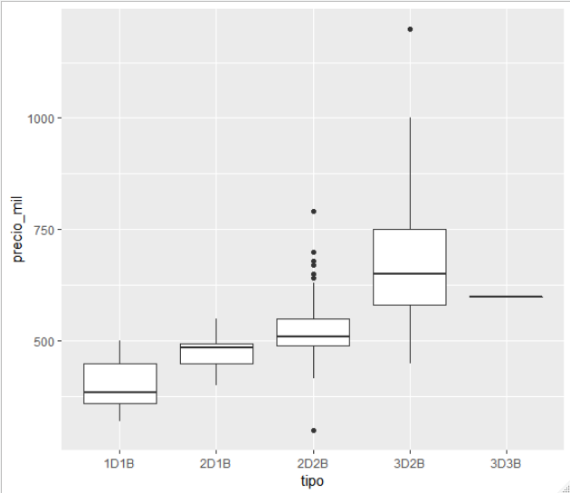
Boxplot por Tipo

Slide 22
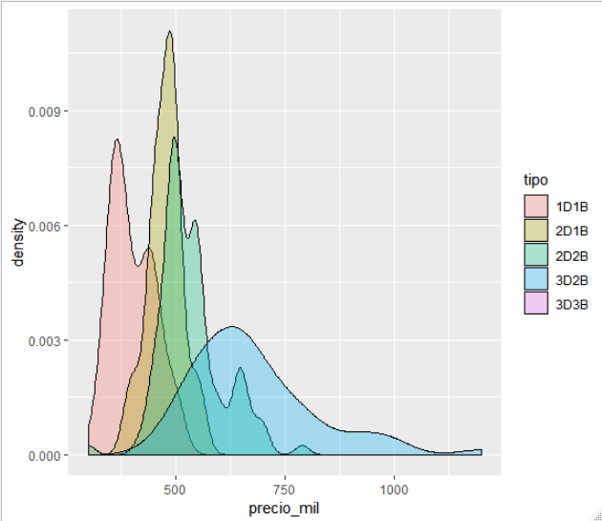
Distribución precio por Tipo

Slide 23
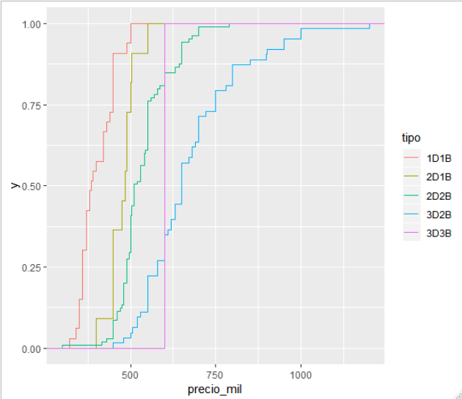
Distribución precio por Tipo

Slide 24
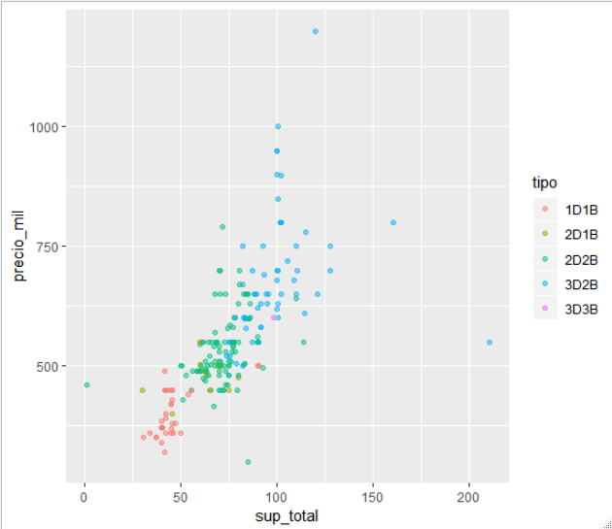
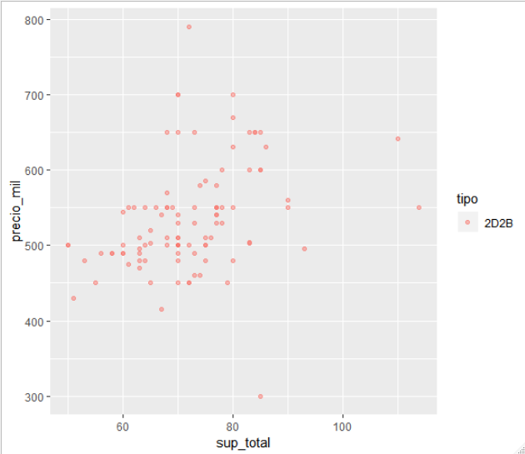
Precio vs Superficie total

